Slide 1
Waardenburg syndrome type 2A & MITF
By Destiny Baars

Slide 2
What does WS2A look like?

Slide 3
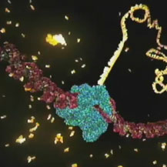
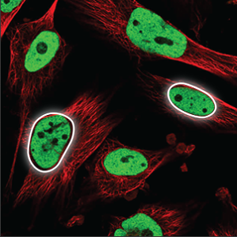
What gene is mutated in WS2A?
520
MITF_TFEB_C_3_N
HLH
DUF3371
Gene Ontology
Molecular Function
Biological Processes
Cellular Components
Notes:
MF: https://www.hhmi.org/sites/default/files/Biointeractive/Images/DNAi_transcription_vo1_thumb_sm.jpg
BP:
CC: http://wiki.eveuniversity.org/images/2/29/PDNucleoplasm.png

Slide 4
How well conserved is MITF?
Human
% Identity
520
MITF_TFEB_C_3_N
HLH
DUF3371
100%
Rhesus
504
99.8%
Chimp
520
99.6%
Mouse
526
94.4%
Zebrafish
500
69.4%
C. elegans
361
4.42%

Slide 5
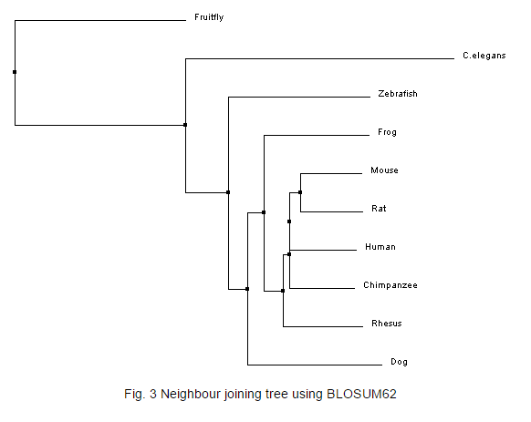
What phylogenetic relationships does MITF have?

