Slide 1
Waardenburg syndrome type 2A & MITF
By Destiny Baars

Slide 2
What does WS2A look like?

Slide 3
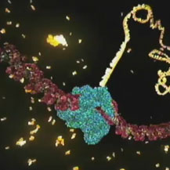
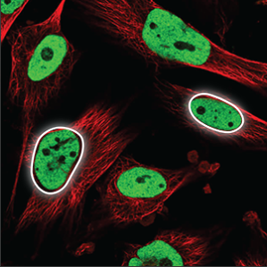
What gene is mutated in WS2A?
MITF
HLH
DUF3371
520
MITF Gene Ontology
Molecular Function
Biological Processes
Cellular Components
Notes:
MF: https://www.hhmi.org/sites/default/files/Biointeractive/Images/DNAi_transcription_vo1_thumb_sm.jpg
BP:
CC: http://wiki.eveuniversity.org/images/2/29/PDNucleoplasm.png

Slide 4
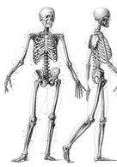
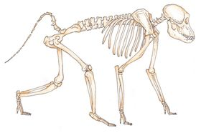
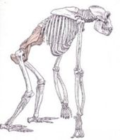
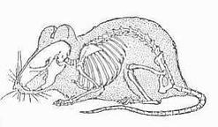
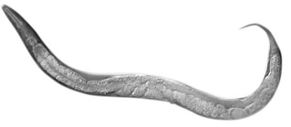
How well conserved is MITF?
% Identity
MITF
HLH
DUF3371
100%
520
99.8%
504
520
99.6%
526
94.4%
500
69.4%
4.42%
361

Slide 5
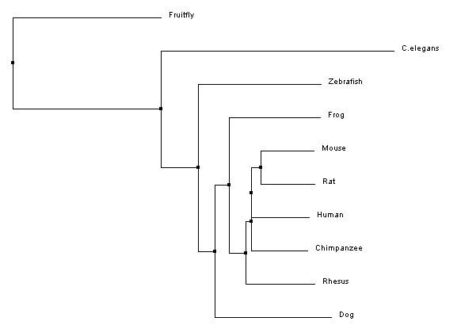
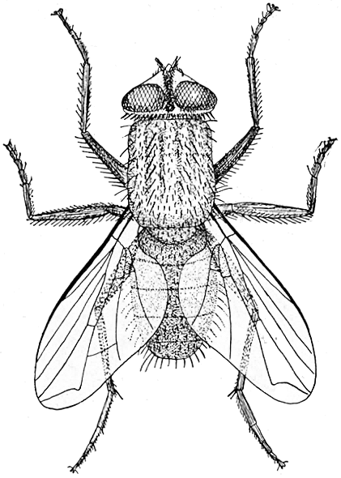
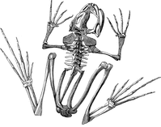
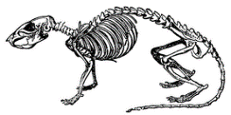
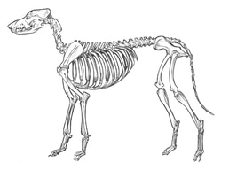
What phylogenetic relationship does MITF have?
Notes:
http://howmed.net/community-medicine/house-fly-characteristics-life-cycle-and-control-measures/

